Slide 1

JWT-based Authentication and
Authorization Implementation
for Online Shopping Platform
Dương Phan Hiếu Nghĩa – 21521179
Nguyễn Đức Hoàng – 21520869
Ngô Trần Thái Sơn - 20521841

Slide 2






Client
Intruder
Server
Product Service
Guest
Authentication Server
Customer
Request
Customer
Service
Seller
Respond
Invoice
Service
Admin

Slide 3
Assets:
User information: usernames, email, addresses, passwords, payment information,..
Transaction data: orders, products, prices, shipping information, and payment details.
System and database: servers, applications, databases, and system infrastructure.
Access rights and authorization

Slide 4
Security goal
Confidentiality
Authentication user
Authentication server
Authorization
Data integrity
Secure session management

Slide 5


Solution
Authentication service
as JWT issuer
1. User authentication request
2. JSON Web Token
Login
Client application
Check the JWT signature,
Access right, Authorization
3. Send a request
(Authentication header)
End users
4. Send respond to client
Token validation

Slide 6
Implement
Private Key: RSA 2048-bit => Sign Token
Public Key: Public => Verify
User Login: Validate -> Generate Token -> Write Cookie
Token expires = 24 hours
Encrypt user password: HMAC with AES-256 4096 bit length
Database: MongoDB
Backend: NodeJS, Express, Cookie-Parser, Body-Parser
Frontend: HTML, Jquery

Slide 7
Testing scenario

Slide 8

Authentication
Guest
Customer
Seller
Admin
Server
Authentication user: username, password
Authentication server: token, public key

Slide 9
Database
Account
Product
Invoice

Slide 10
Authorization by role
Guest
Customer
Seller
Admin
View all account Set role user
Delete account
View all product
Delete product
View all invoice
Delete invoice
View Profile
Update Information
Change Password
View Profile
Update Information
Change Password
Invoice
View Profile
Update Information
Change Password
View Product
Add Product
Home
Login
Register

Slide 11
Demo

Slide 12
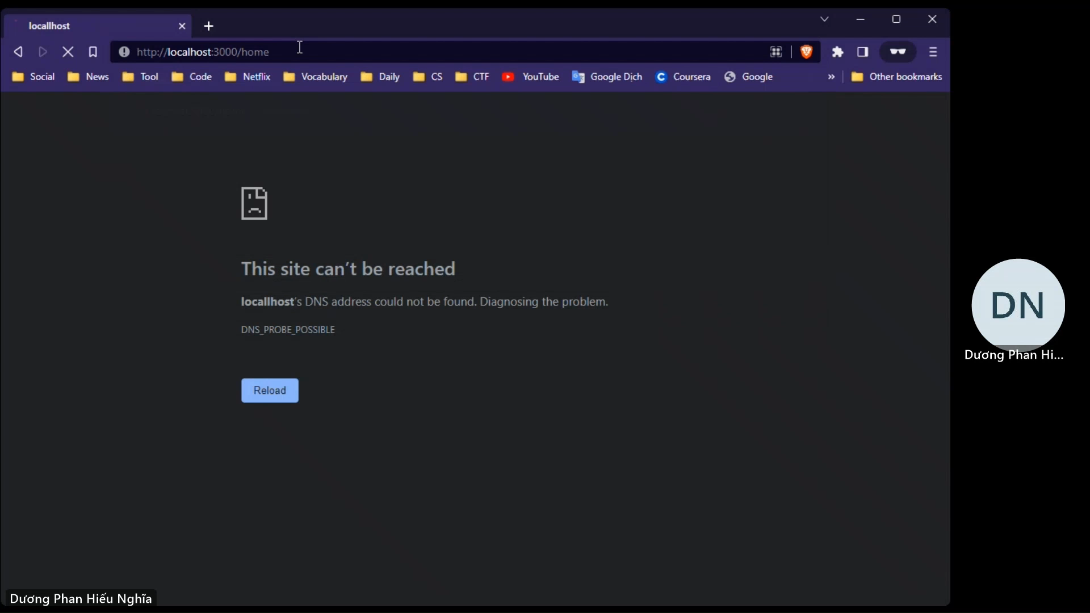
Guest

Slide 13
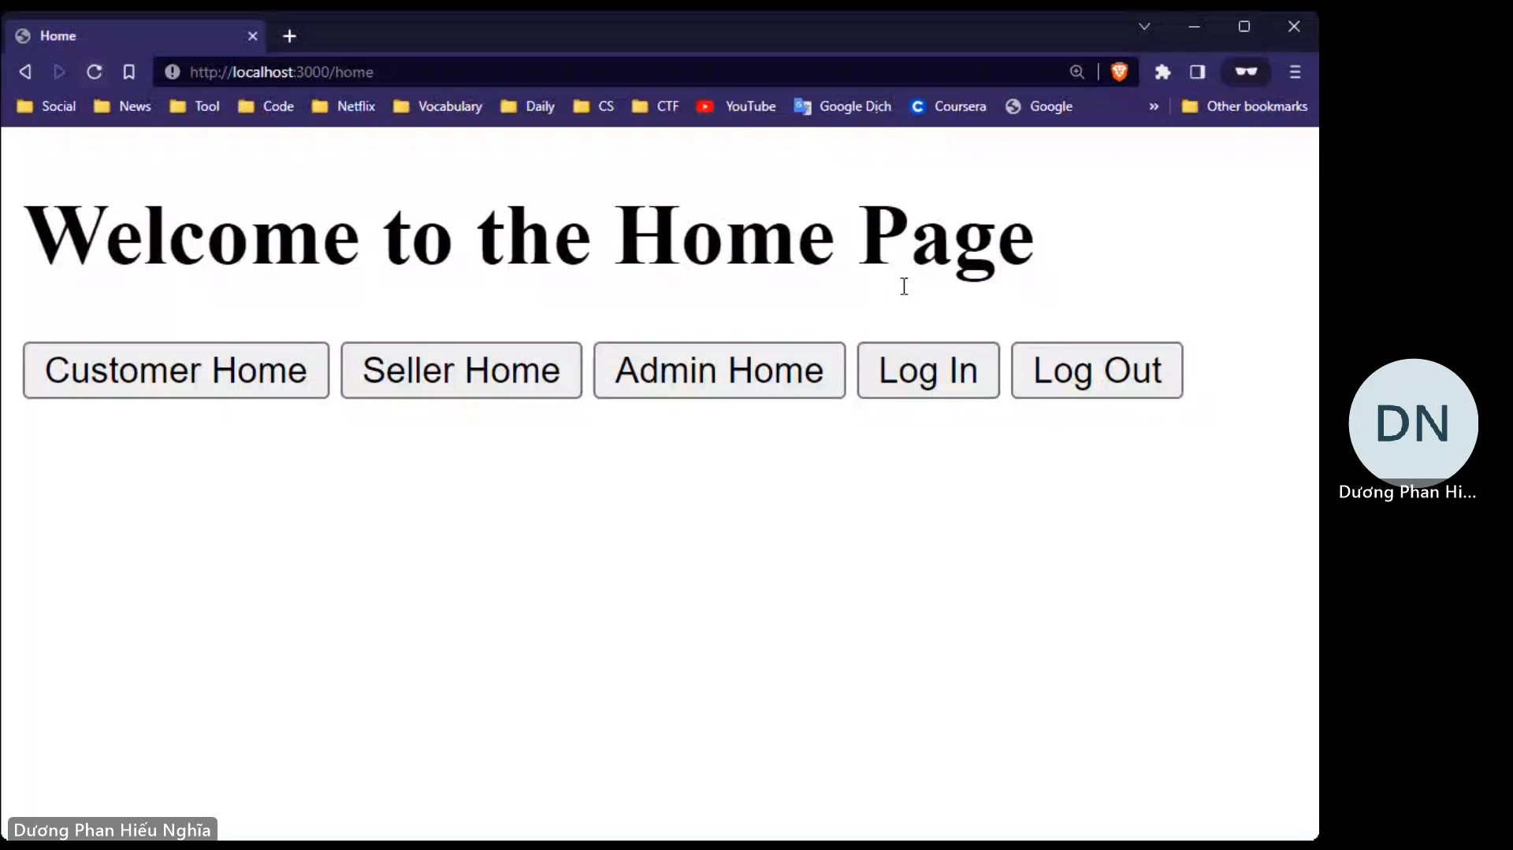
Customer

Slide 14
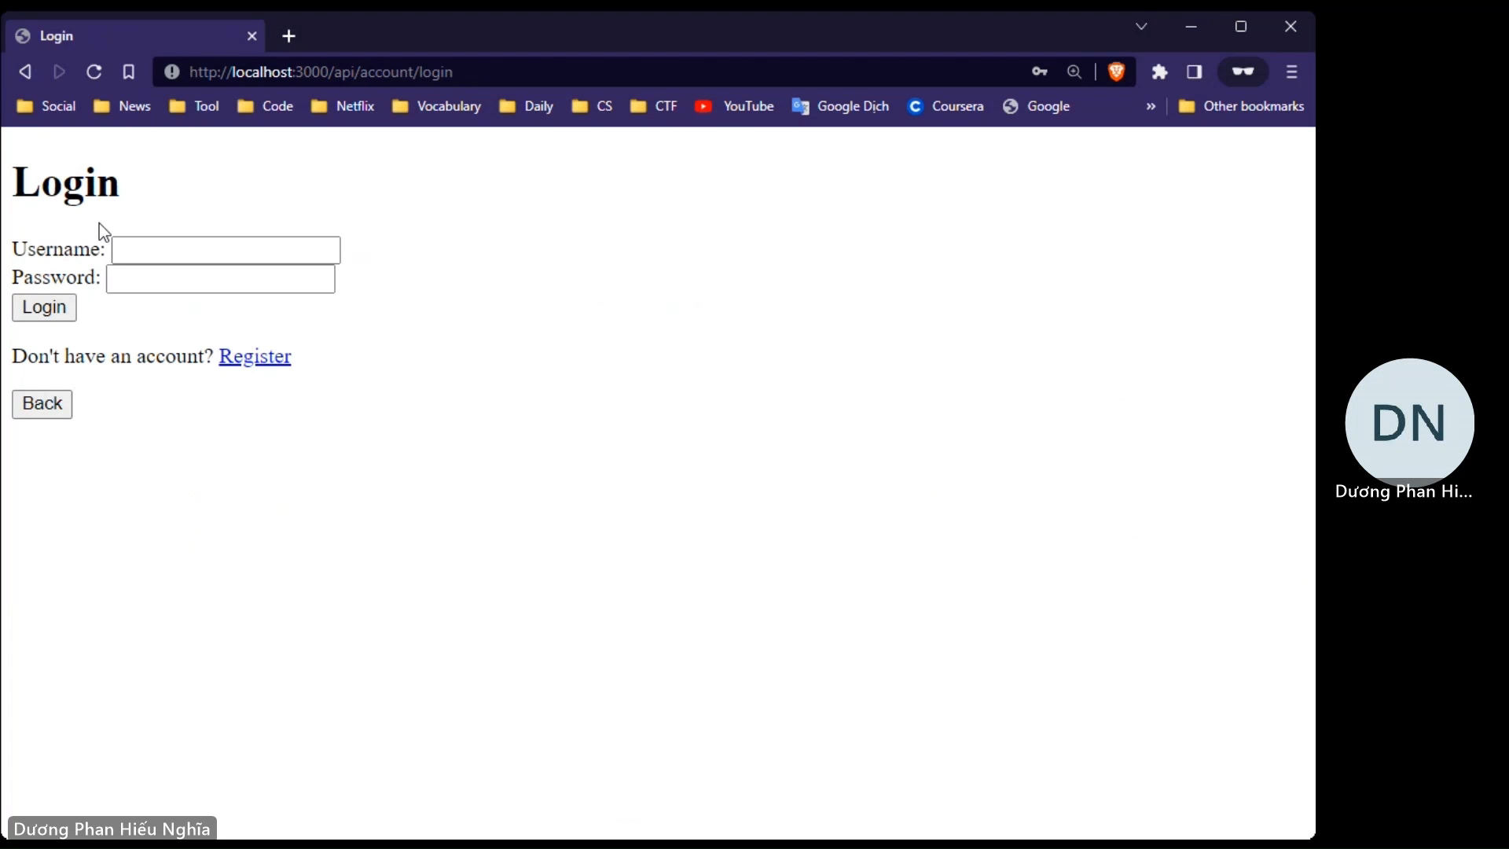
Seller

Slide 15
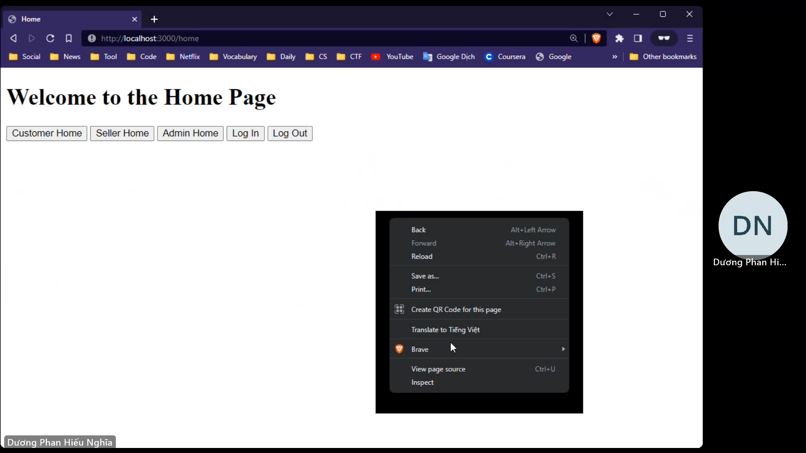
Admin

Slide 16
Reference:
 de Almeida MG, Canedo ED. Authentication and Authorization in Microservices Architecture: A Systematic Literature Review. Applied Sciences. 2022; 12(6):3023. https://doi.org/10.3390/app12063023
 Authentication and Authorization of End User in Microservice Architecture To cite this article: Xiuyu He and Xudong Yang 2017 J. Phys.: Conf. Ser. 910 012060
https://iopscience.iop.org/article/10.1088/1742-6596/910/1/012060/pdf

Slide 17
Task Assignment
Task | Sơn | Nghĩa | Hoàng | Status
Article | X |  | X | 
Database | X |  | X | 
Backend |  | X | X | 
Frontend | X | X |  | 
Docker | X
PowerPoint |  | X | X | 
Demo |  | X | X | 
Presentation | X | X |  | 
Report | X | X | X | 

